Slide 1

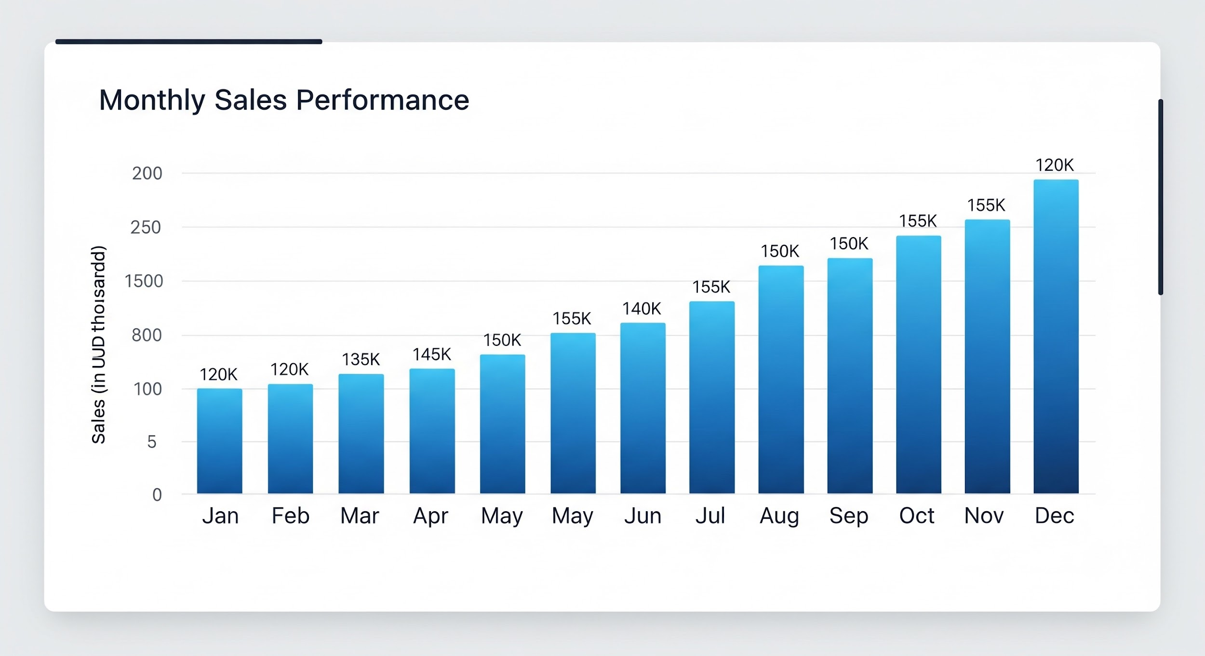
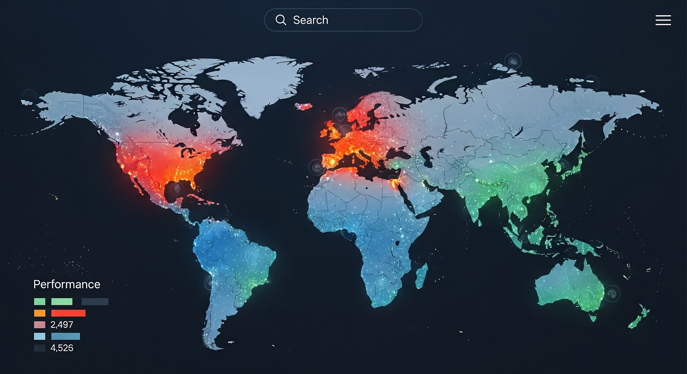
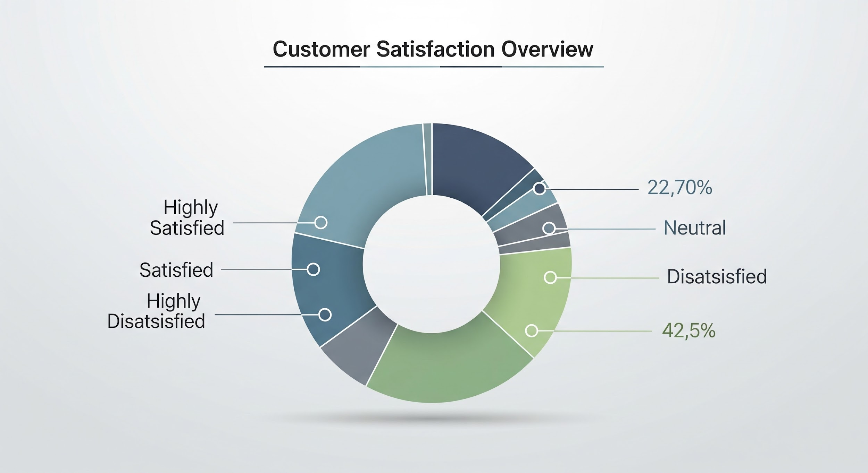
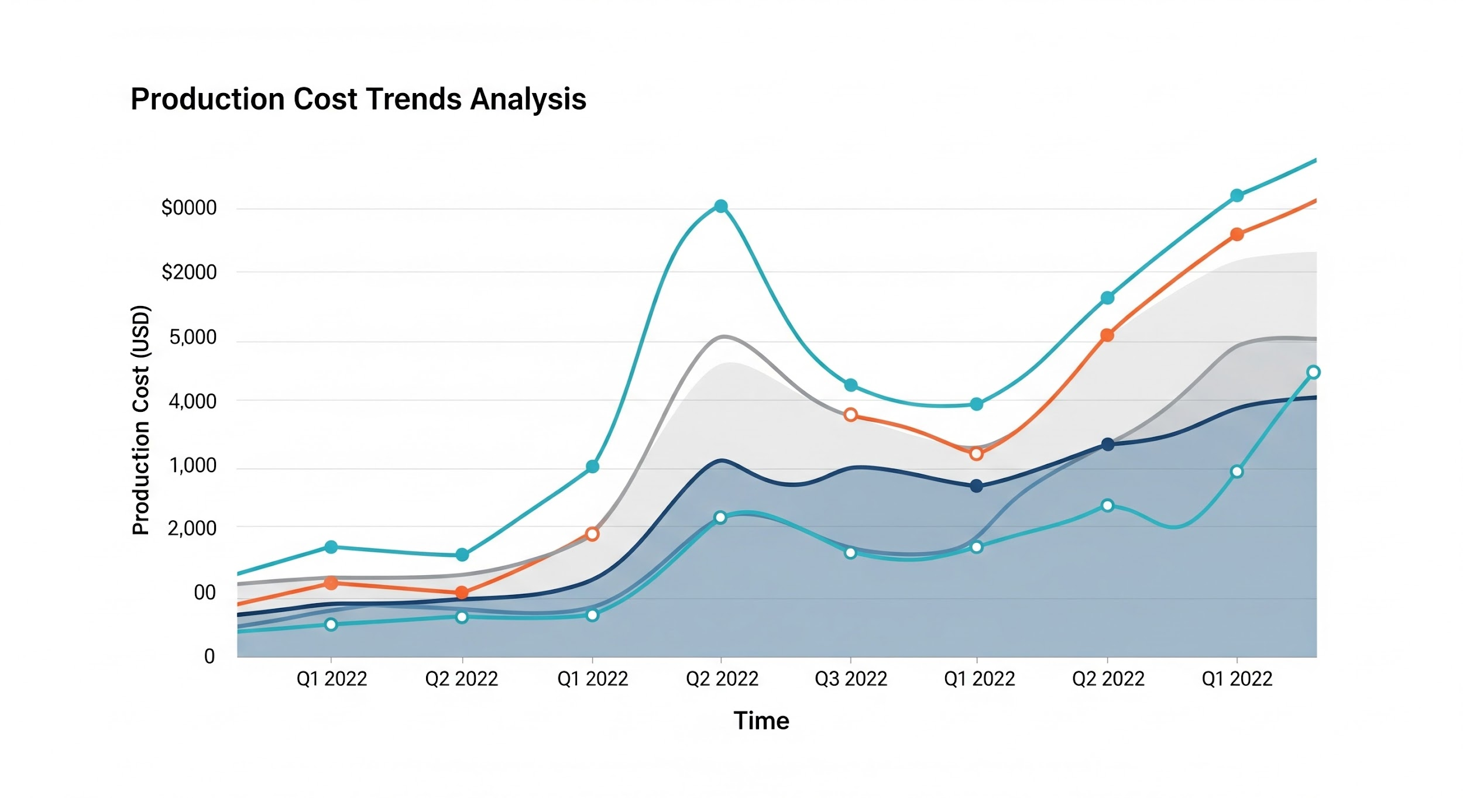
Dashboard design template
Sales overview (bar chart)
Regional performance (map/geo chart)
Production cost trends (line chart)
Customer satisfaction (pie chart)
Sketch your dashboard layout in this space. Consider using pen and paper, a presentation program, or a free online diagramming tool.

Slide 2
